Slide 1
Teacher AI
TEAM: Milanesiimbruttiti

Slide 2

Agenda
Topic one
Topic two
Topic three
Topic four

Slide 3

Team
Andrea Ierardi
Matteo Pasotti
Marco Vinciguerra
Alessandro Belotti
Alessio Galluccio

Slide 4

Introduction
Teacher AI is a web application with a professor generated by Artificial Intelligence. It presents elementary lesson about different topics: English, Science and Math. The objective is to guarantee education in different part of the world, especially countries that do not guarantee a decent level of education for children.

Slide 5
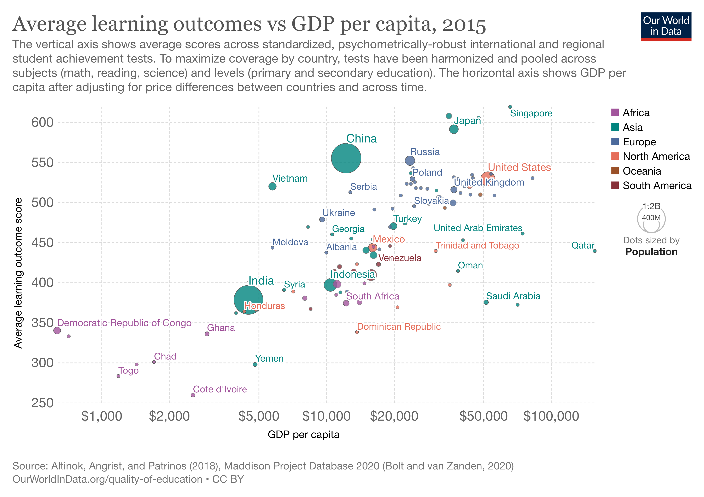
The issue
Bla bla

Slide 6
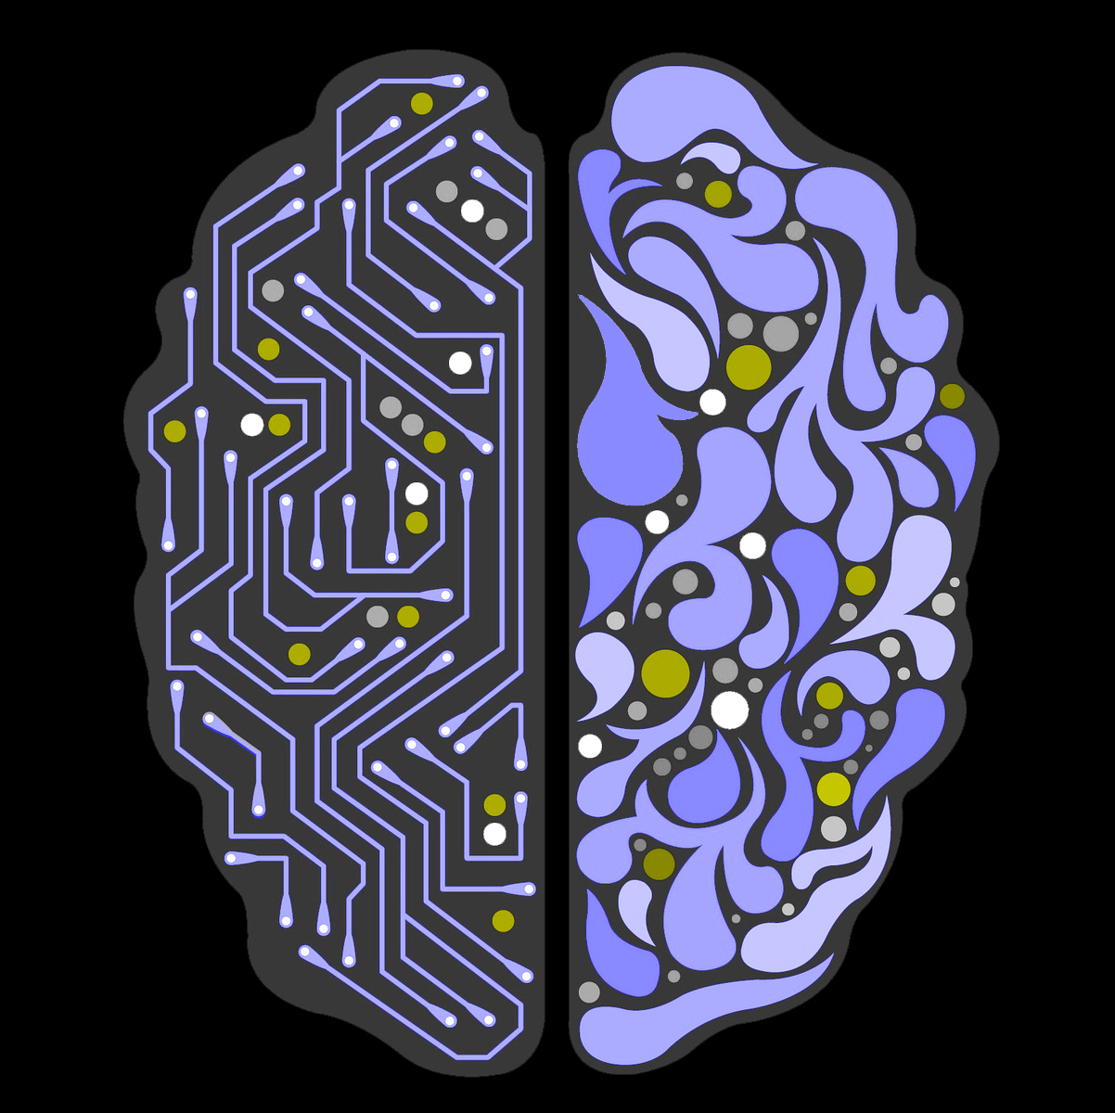
Our solution
Develop a Web App to help the spread of knowledge among children in underdeveloped countries:
-

Slide 7
Tools and Models
Tools
Models
Jupyter Notebook for primary experimental phase
Streamlit to create and deploy the WebApp
ChatGPT for generating syllabus
GPT3 to generate text of the lesson

Slide 8
How it works

Slide 9
DEMO

Slide 10
AI Teacher Project
Target
Make
Children between 5-12 in underdeveloped countries
Children in every part of the world that need an educational reinforcement
Improve quality of education
Guarantee a decent level of education in every part of the world
Educate children on Artificial Intelligence

Slide 11

Future Steps
Implement with ChatGPT API
Allow the possibility to add custom syllabus by a children tutor

Slide 12
Table
 | Category 1 | Category 2 | Category 3 | Category 4
Item 1 | 4.5 | 2.3 | 1.7 | 5
Item 2 | 3.2 | 5.1 | 4.4 | 3
Item 3 | 2.1 | 1.7 | 2.5 | 2.8
Item 4 | 4.5 | 2.2 | 1.7 | 7

Slide 13
Timeline
Title
To start a presentation, go to the Slide Show tab, and select From Beginning.
Title
To display Presenter view, in Slide Show view, on the control bar at the bottom left select the three dots, and then Show Presenter View.
Title
During your presentation, the speaker notes are visible on your monitor, but aren't visible to the audience.
Title
The Notes pane is a box that appears below each slide. Tap it to add notes.
Title
If you don’t see the Notes pane or it is completely minimized, click Notes on the task bar across the bottom of the PowerPoint window.

Slide 14
Title
Subtitle
Subtitle
Add text, images, art, and videos.
Add transitions, animations, and motion.
Save to OneDrive, to get to your presentations from your computer, tablet, or phone.
Open the Design Ideas pane for instant slide makeovers.
When we have design ideas, we’ll show them to you right there.

Slide 15
Title
Subtitle
Subtitle
Subtitle
Add text, images, art, and videos.
Add transitions, animations, and motion.
Save to OneDrive, to get to your presentations from your computer, tablet, or phone.
Open the Design Ideas pane for instant slide makeovers.
When we have design ideas, we’ll show them to you right there.
This PowerPoint theme uses its own unique set of colors, fonts, and effects to create the overall look and feel of these slides.
PowerPoint has tons of themes to give your presentation just the right personality.

Slide 16



Summary
With PowerPoint, you can create presentations and share your work with others, wherever they are. Type the text you want here to get started. You can also add images, art, and videos on this template. Save to OneDrive and access your presentations from your computer, tablet, or phone.

Slide 17




Thank you
Presenter name
Email address
Website

